Slide 1
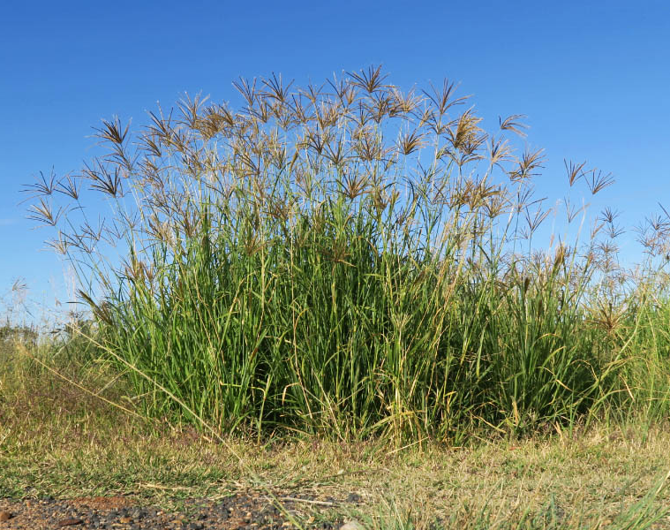
LLM based extraction of biosecurity data from a corpus
Christopher E. Buddenhagen
Hawaii Biosecurity Symposium Workshop
18 June 2026 1020 AM
Chloris gayana
Notes:
Make sure everyone is on here.

Slide 2
Goals
Workshop Purpose
Introduce use of large language models to extract structured biosecurity (or any) data from scientific literature efficiently.
Hands-on Pipeline Execution
Participants configure and run a general R pipeline with example datasets and documented scripts.
Workshop Structure
Quickly cover background, motivation, pipeline overview, guided execution, and output interpretation.
Expected Outcomes
Understand pipeline functionality, inputs, outputs, and adaptation for biosecurity questions.

Slide 3

Using API for AI prompt completion - background
Corpus
Title_abstract
Identify hazards (species) of concern
Location
Host-pest relationships
Habitat
Impact
Types of weeds/invaders
OpenAI
model
gpt-4o-mini
Extracted information
Prompts
GBIF taxonomy

Slide 4
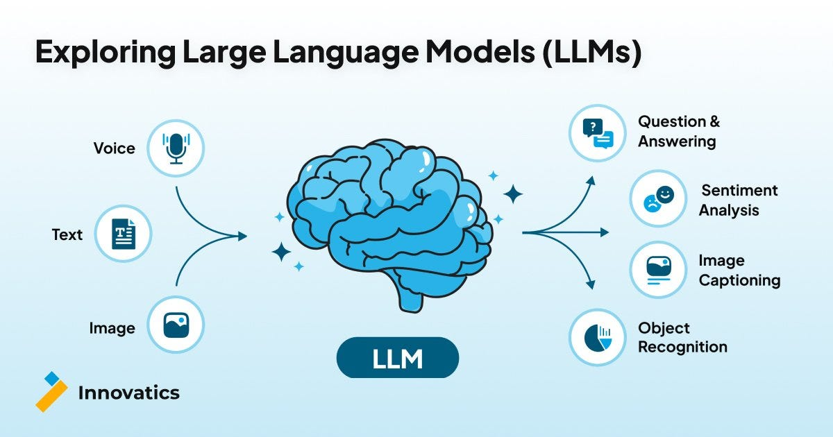
LLM
LLM API options are many, OpenAI, Ollama, Gemini, Claude etc
Chat completion
Tokens
Model choice gpt-4o-mini vs newer ones

Slide 5
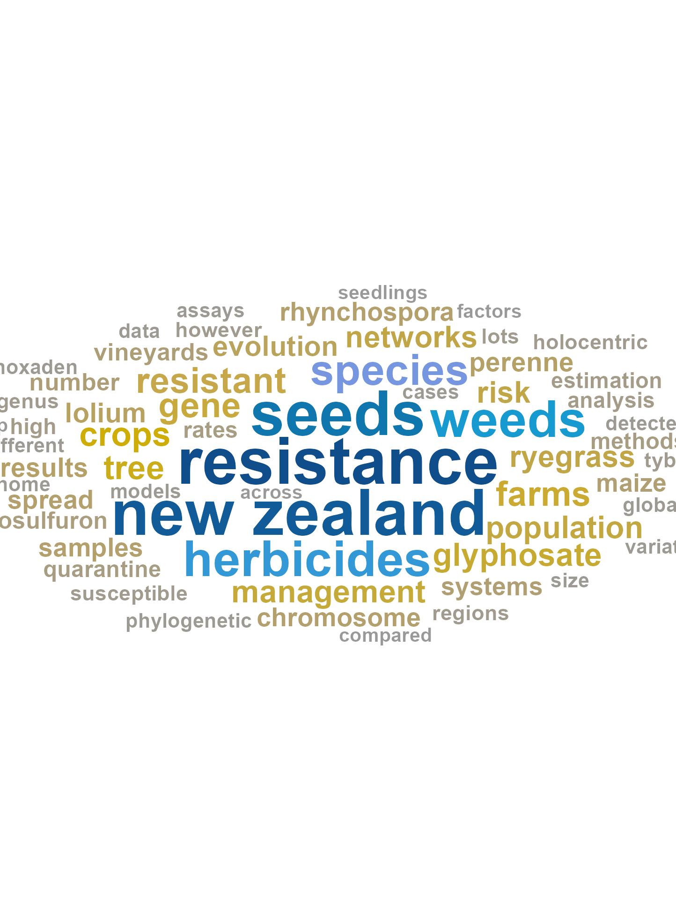
Turning Unstructured Text into Structured Biosecurity Data
Unstructured biosecurity “corpus”
Automating Text Extraction
Large language models automate extraction of key biosecurity info from scientific text efficiently.
Structured Data Output
Constrained, human-readable outputs enable easy storage and analysis using standard data tools→R in this case.
Supporting Not Replacing Expert Judgement
This approach enhances expert review by triaging literature and highlighting critical species and topics.
Biosecurity Applications
Technique supports hazard identification, evidence gathering, and prioritization in biosecurity contexts
Lantana camara
Psidium cattleianum
Cenchrus clandestinus

Slide 6
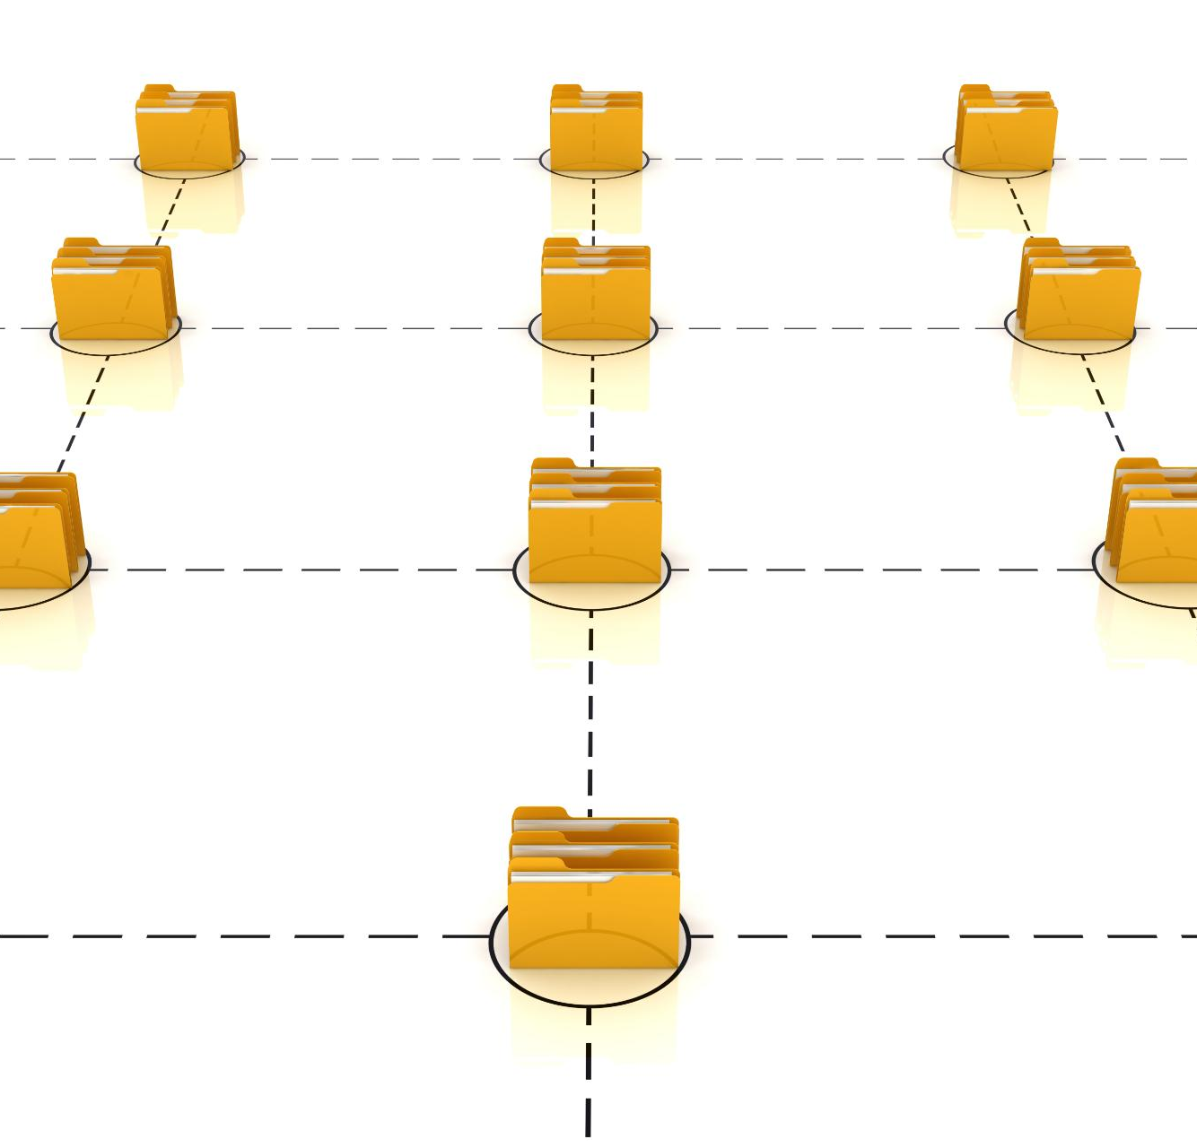
Files and project structure
Single Repository Setup
All workshop materials except the API key are provided in a single repository for simplicity and easy access.
https://cbud.github.io/biosecurity-symposium/ website explanation
https://github.com/cbud/biosecurity-symposium repository
https://github.com/cbud/biosecurity-symposium/archive/refs/heads/main.zip download most of what you need
Folder Organization
The project uses folders like corpus, prompts, and functions to separate components clearly.
Main Script Coordination
A main script orchestrates the workflow, handling the pipeline from start to finish with minimal modification.
Workshop Focus
We will focus on running scripts and understanding input-output without deep code changes.

Slide 7
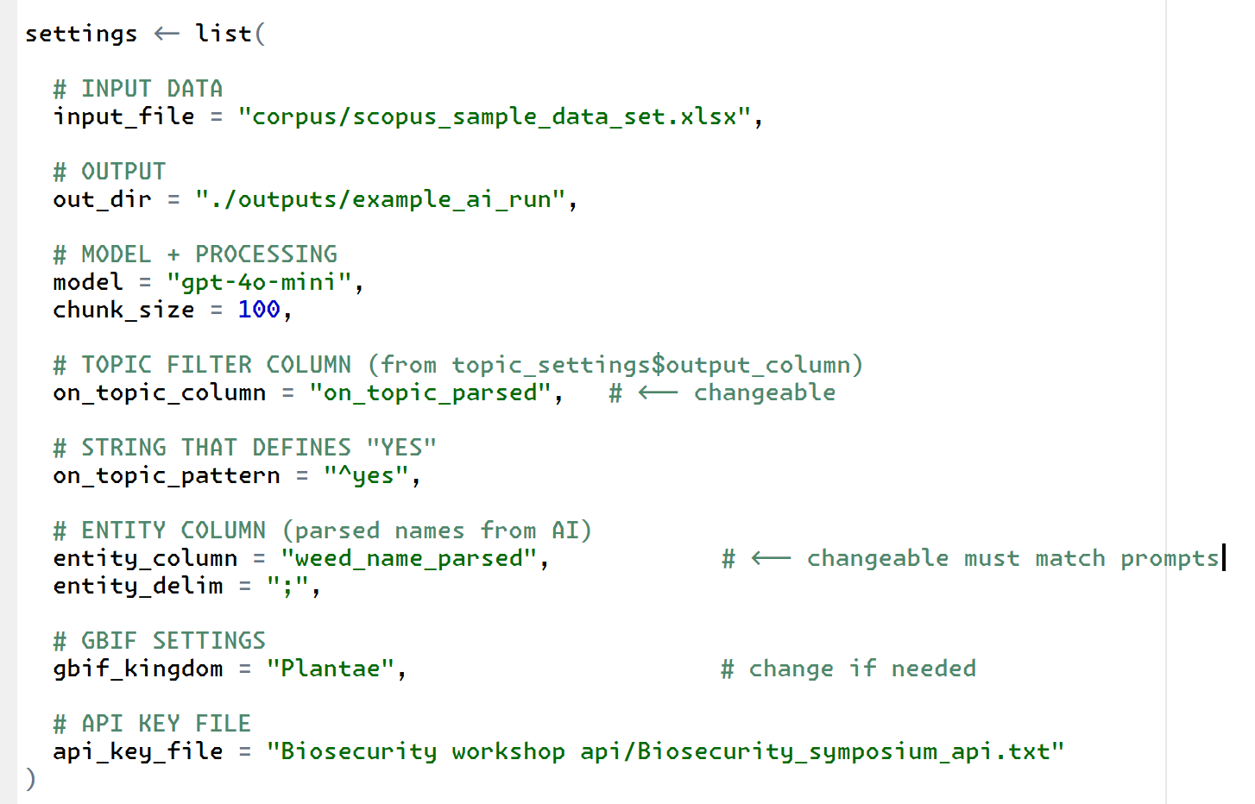
Open script and make some changes
Open these files
AI biosecurity workshop generalized.R
source("prompts/prompt_1.R")
Run the setup chunks – modify as needed.
You can change the prompts for new topics
← You can create a new one
←Change this to match location of the file

Slide 8
In example: topic filtering then species extraction
Topic Filtering Step
The model classifies documents as relevant or off-topic using simple yes/no questions, enabling efficient filtering.
Species Extraction Step
The model extracts specific species names formatted for automated processing, supporting detailed data analysis.
Other information could be extracted and if we have time you can try it
You could add some prompts to a new prompt file if we have time.
Controlled LLM Pipeline Use
LLMs function as controlled components, not free-form generators, within a biosecurity data-processing pipeline. Current scripts work with older models than gpt-5 , set up is with gpt-4o-mini
Biosecurity Application Benefits
This approach enables rapid scanning of texts to identify frequent species and potential hazards in biosecurity.
On topic
On topic
On topic

Slide 9
Understanding the results
Master Dataset Composition
The final dataset merges bibliographic data with AI-derived variables like topic relevance and species names.
Summary Tables for Analysis
Summary tables present publication counts for species, serving as proxies for research attention and impact.
Critical Evaluation Encouraged
Participants are urged to verify AI outputs with original abstracts and consider the meaning behind the numbers.
AI Enables Rapid Synthesis
AI accelerates transparent synthesis of vast literature, enabling efficient biosecurity hazard ranking.

Slide 10
Rerun with your own topic added
Paste the old prompt into OpenAI chat or another AI chat provider to “Provide a modified script following the example I give it should add an additional topic that distinguishes whether the weed or invasive plant in the text is mentioned in a conservation, agricultural, forestry or other context. The contexts should be output as a concise semicolon separated list of values. Respond concisely”
Create a prompt_new.R file
Rerun the generalized script after updating file location for the prompt and the directory for the outputs.

Slide 11
LLM data recovery steps reiterated: identify weed binomials
Compile a dataframe with the corpus (text for querying with AI), with one row per source title abstract keywords are merged in this case https://github.com/cbud/biosecurity-symposium/blob/main/corpus/scopus_sample_data_set.xlsx
R script for the generalized pipeline is in the https://github.com/cbud/biosecurity-symposium/blob/main/AI%20biosecurity%20workshop%20generalized.R
Load packages
Prime your system to work with API key https://github.com/cbud/biosecurity-symposium/blob/main/AI%20biosecurity%20workshop%20generalized.R
Set pipeline directories, specify location of the API key text file, and models and chunk size – merge into single file for all citations scanned.
Develop a prompt for use with an OpenAI model (e.g. GPT‑4o‑mini) https://github.com/cbud/biosecurity-symposium/blob/main/prompts/prompt_1.R
Run the prompts across the dataframe – functions: https://github.com/cbud/biosecurity-symposium/blob/main/functions/f_ai_text_analysis.R
Standardise names to the GBIF backbone: https://github.com/cbud/biosecurity-symposium/blob/main/functions/f_get_gbif_backbone_ids_from_df.R

